Slide 1
FIFA PROJECT
By:
Aditya Sreedhar, Bhaskar Bharat, Ekanki Agarwal and Bharat Rengarajan

Slide 2
Objective: Predict the Overall (OVR ) skill Statistic for players in the FIFA 2020 Edition
Part A – Rank the Players
The features used for the particular problem were broadly classified into following groups. There were 103 features to start with.

Slide 3
Main Ideas: The keys points about the predictive modelling exercise are summarized below:
Any player in the game is given an overall rating statistic in the range 0-100
Few features (20) like player position, player url, date of birth, etc were dropped based on human judgement.
It was assured that factors from all the feature groups were considered for modelling analysis
Exploratory Analysis was carried out for few predictors. Basis the analysis, variables like preferred foot, body type, work rate and player position were dropped.
Moderate Correlation among quite a few predictors was observed
Threshold of 20% was used for initial shortlisting of features based on correlation with overall rating.
Finally, 62 features were used for modelling exercise. Following Modelling techniques were used:

Slide 4
Key Results:
The following results were observed:
K-NN was clearly overfitting the data and was also underperforming (cross validation MSE of around 0.04) as compared to the above two models.
Logit regression with L2 penalty was chosen as the final model.
Features like movement reactions, value of the player, skill ball control, mentality composure , physic, power strength were few of the variables which were found to be important in predicting the overall rating of the player. Hence, adequate coverage of factors was seen in predicting the variables.
On the test data, following results were obtained:

Slide 5
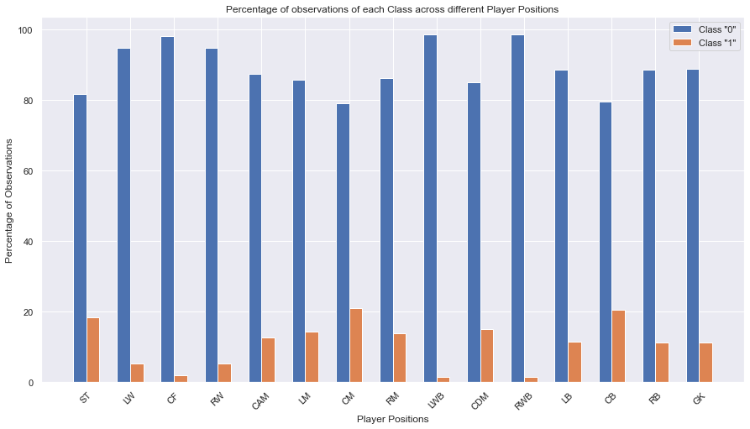
Part B – Classify Player Position
Objective: Train on data from FIFA 19. Predict the player_position variable using other skill statistics for players in the FIFA 20 Edition. Train on all players from FIFA 19
Cleaned and Preprocessed the Train and Test Data
One-Hot Encoded the unique player_positions
3. Checked Class Imbalance

Slide 6
Model 1 : Binary Relevance 1
In this case an ensemble of single-label binary classifiers is trained, one for each class. Each classifier predicts either the membership or the non-membership of one class. The union of all classes that were predicted is taken as the multi-label output. This approach is popular because it is easy to implement, however it also ignores the possible correlations between class labels.
In other words, if there’s q labels, the binary relevance method create q new data sets from the images, one for each label and train single-label classifiers on each new data set. One classifier may answer yes/no to the question “does it contain trees?”, thus the “binary” in “binary relevance”. This is a simple approach but does not work well when there’s dependencies between the labels. Source: https://towardsdatascience.com/journey-to-the-center-of-multi-label-classification-384c40229bff
Model 2 : Binary Relevance 2
In this model we tried to overcome one of the shortcomings of the BinaryRelevance1 Classifier, that is, ignorance of the possible correlations between class labels.
Here, we have added all the response variables but the one we are predicting for as part of our feature matrix to take into account the possible correlations between class labels.
Model 3 : Classifier Chains
A chain of binary classifiers C0, C1, . . . , Cn is constructed, where a classifier Ci uses the predictions of all the classifier Cj , where j < i. This way the method, also called classifier chains (CC), can take into account label correlations.
The total number of classifiers needed for this approach is equal to the number of classes, but the training of the classifiers is more involved.
Following is an illustrated example with a classification problem of three categories {C1, C2, C3} chained in that order. Source: https://towardsdatascience.com/journey-to-the-center-of-multi-label-classification-384c40229bff
The Absolute Accuracy Score is not a good metric for Multi_Label Classification as we can observe from the above score. The mean validation accuracies of each player_positions are decent enough but the overall accuracy score is quite low. So, we need to evaluate our results based on other metrics such as Precision, Recall and F1 score values.
The Best Overall Accuracy Score was observed for BinaryRelevance2 Classifier which is 23%.

Slide 7
We can improve the Precision and F1 Score by varying the threshold value on Player_Position Level.
Overall the best Mean F1 Score at Player Level was observed in case of BinaryRelevance2 Classifier which is 66%.
Overall the best Mean Accuracy Score at Player_Position Level was observed in case of BinaryRelevance2 Classifier which is 86%.
We can observe that by changing the threshold from 0.5 to 0.77 :
Mean Precision Score improved from 56% to 71%.
Mean F1 Score improved from 66% to 74%.
There are other ways we can improve our models by:
Changing Threshold at player_position level.
Trying different C (Regularization Coefficient) values.
Trying different types of Regularizations such as L1 Regularization, Elastic Net etc.

Slide 8
Part C - Which Club has the Best Staff
The best staff always help their players grow, can you identify that using historical data?
Study player data from Division 1 European League* players from the last 5 Years.
Analyze changes in player stats and value. Rank the clubs according to best increase in statistics of a player
Graphically represent the scores for the test set
Details :
Sofifa Id, URL, Wage, Salary, Name, Real face, URL variables cannot be used during the prediction or learning.
Assign a score to all clubs out of 100, and represent it in an appropriate visualization. With 100 being the highest
For the test set, your model will be scored using MSE against the average of all models of the class.
(Score = MSE( Your Values , Average of all models values))
The test set is as follows for this problem statement (Division 1 European League):
Leagues to be considered
Premier League - English Premier League
Bundesliga German 1. Bundesliga
Ligue 1 French Ligue 1
La Liga Spain Primera Division
Serie A Italian Serie A

Slide 9
Approach
First, the player stats were converted into club stats by taking averages across multiple categories. The following columns were selected as features for each club:
'avg_overall','avg_potential','avg_pace','avg_shooting','avg_passing','avg_dribbling','avg_defending','avg_physic','avg_attacking','avg_skill','avg_movement','avg_power','avg_mentality','avg_defending','avg_GKstats’
Incremental values were calculated by computing the differences in each stat for each club, between one season and the previous one. For example: FIFA16[‘avg_overall’]-FIFA15[‘avg_overall’]
Each column was assigned a pre-defined bias value and a pre-defined multiplier. The bias and multiplier were assigned based on feature importance with ‘avg_overall’ having the highest values and ‘avg_GKstats’ with the lowest values.
After computing the score for each column using the above values, the total score was calculated by adding the individual scores for all 5 seasons.

Slide 10
Result
Top 10 teams and scores:
Angers SCO | 88.21604
Leicester City | 87.60807
FC Bayern München | 86.65541
Tottenham Hotspur | 86.30033
SD Eibar | 85.62901
Watford | 85.09843
Bayer 04 Leverkusen | 85.00244
OGC Nice | 84.9235
Real Madrid | 84.70978
SV Werder Bremen | 82.92663

